Slide 1

AI Based Forest Inventory
Group Members:
Noman Shahid (22P-9029)
Ahmad Waheed(22P-9031)
Sadaqat Ali Shakir(22P-9223)
Project Supervisor:
Dr.Bilal Jan
Co-Supervisor
Dr Omar Usman

Slide 2
Introduction
Our project is an AI-based system that automatically detects and counts trees from point cloud data.
Instead of performing manual forest surveys, we segment each tree, extract essential attributes such as height and crown diameter, and store this information in a database as a digital forest inventory.
This inventory can be used for tree monitoring, forest management, and tracking changes over time.
The overall goal is to make forest analysis faster, more efficient, and more accurate using AI techniques.

Slide 3
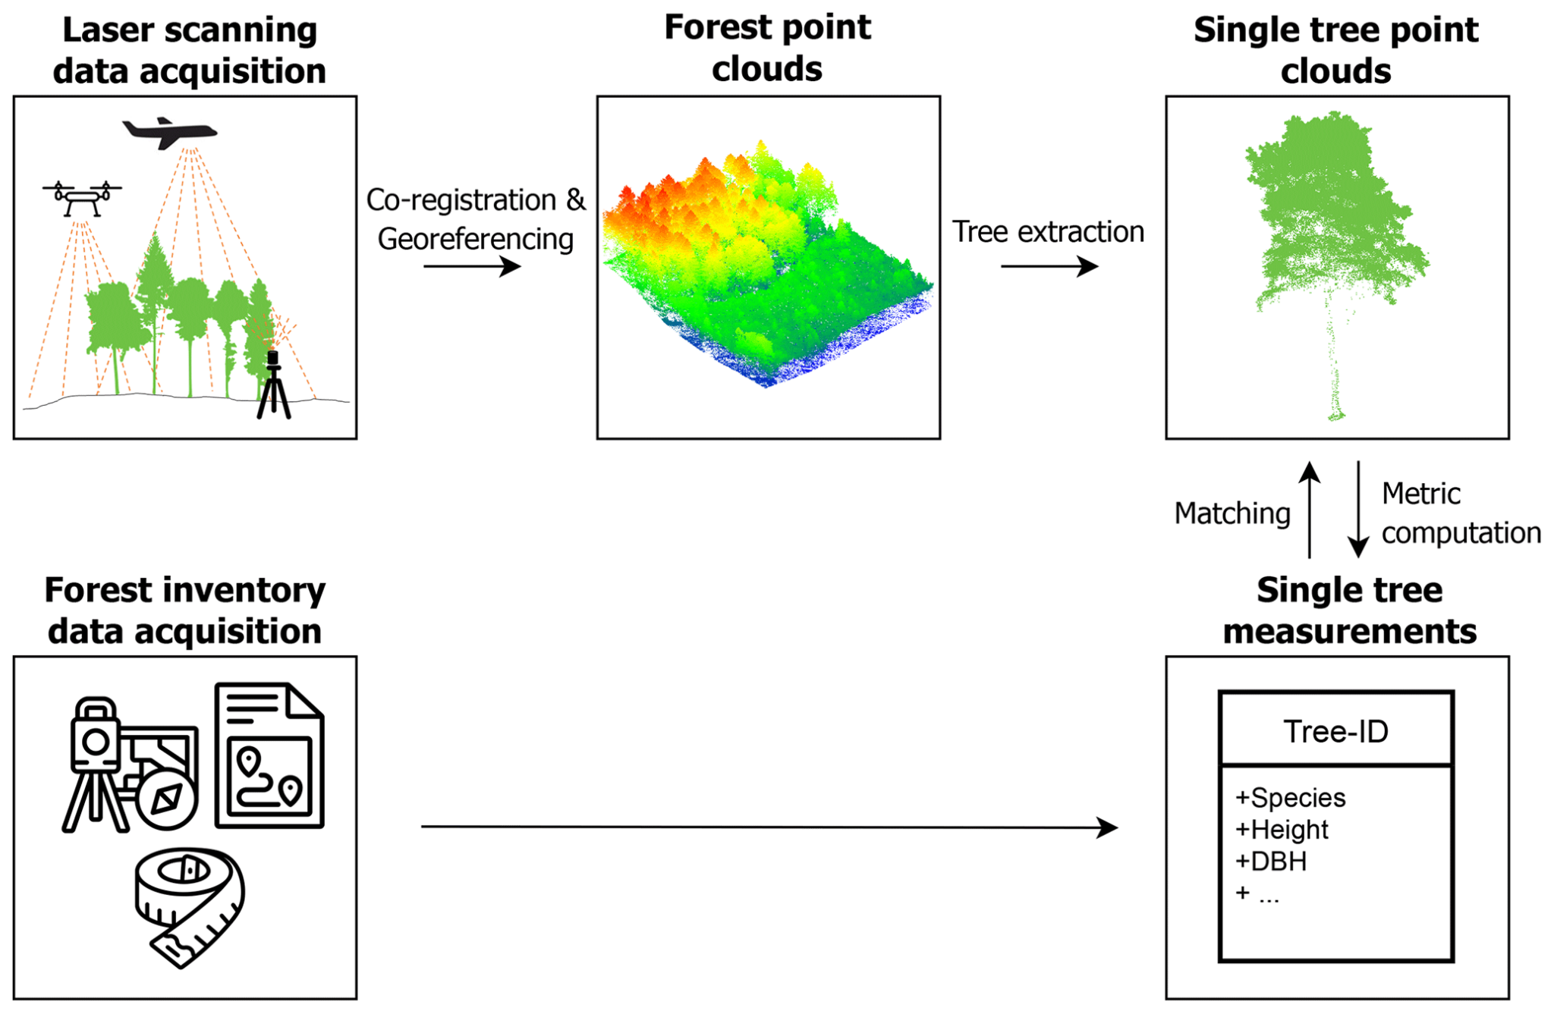
Workflow Diagram

Slide 4
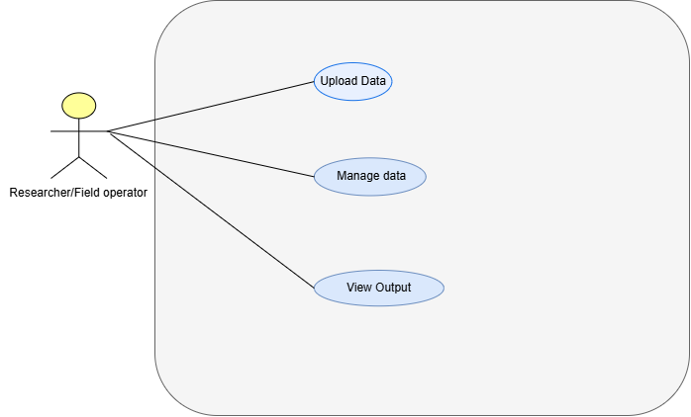
Use Case Diagram

Slide 5
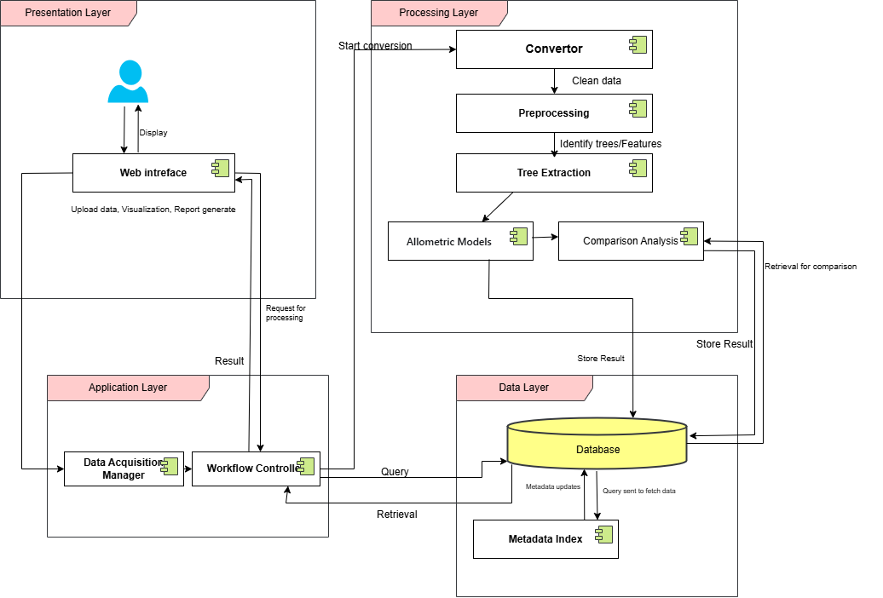
Layered Architecture Diagram

Slide 6
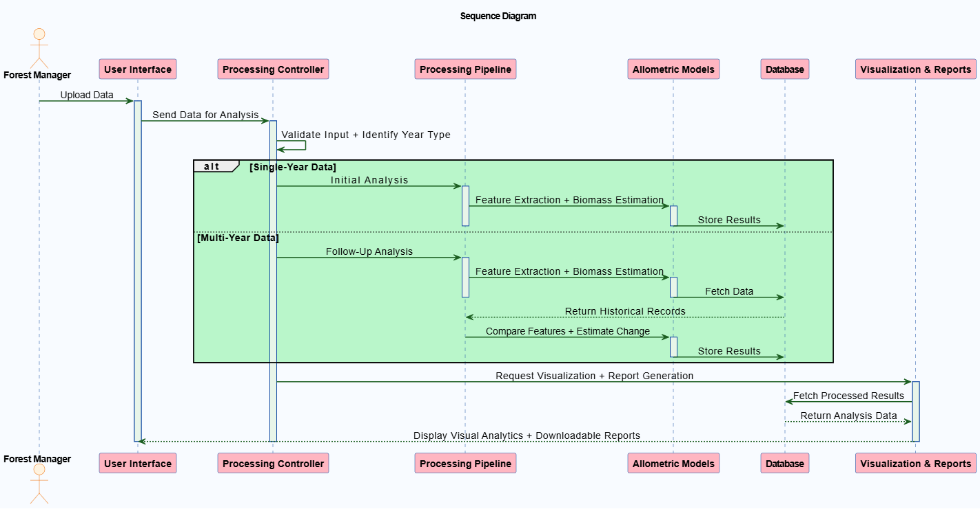
Sequence Diagram

Slide 7
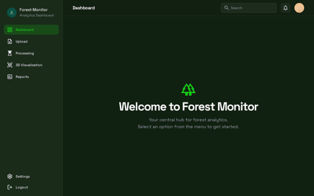
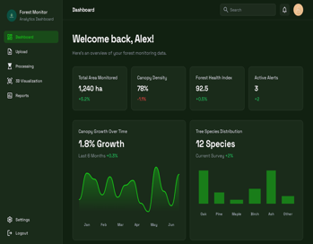
UI/UX
Upload Data
DashBoard & Insights

Slide 8
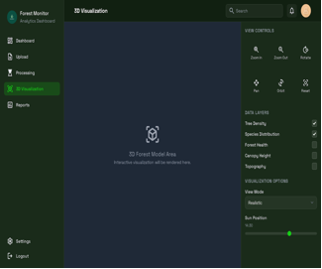
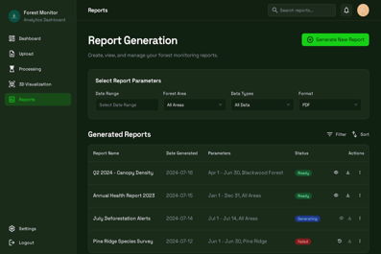
UI/UX
Reports & Visualization

Slide 9
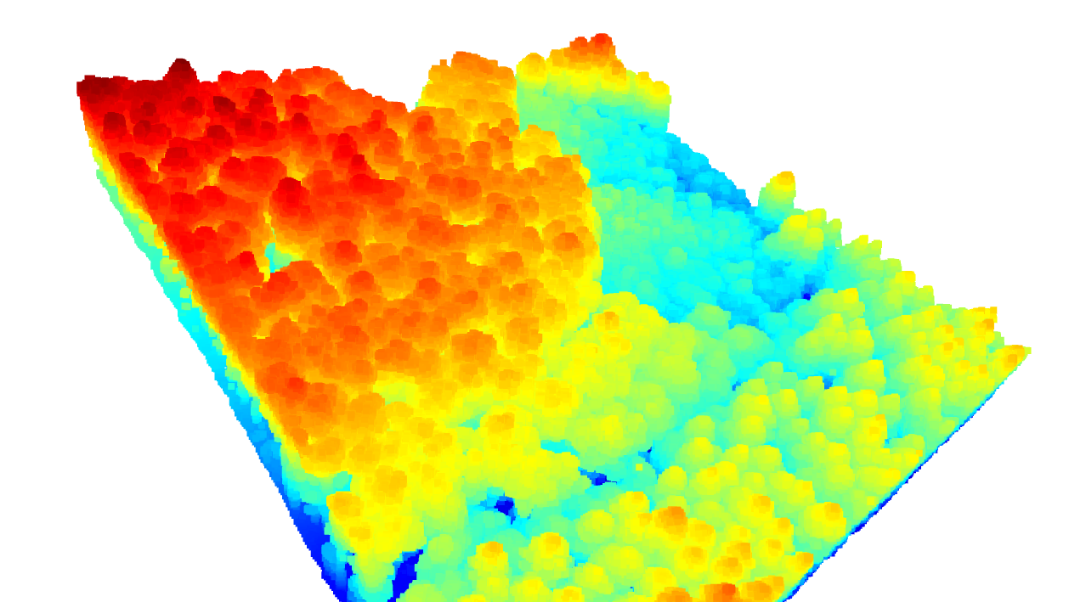
Dataset Preview

Slide 10
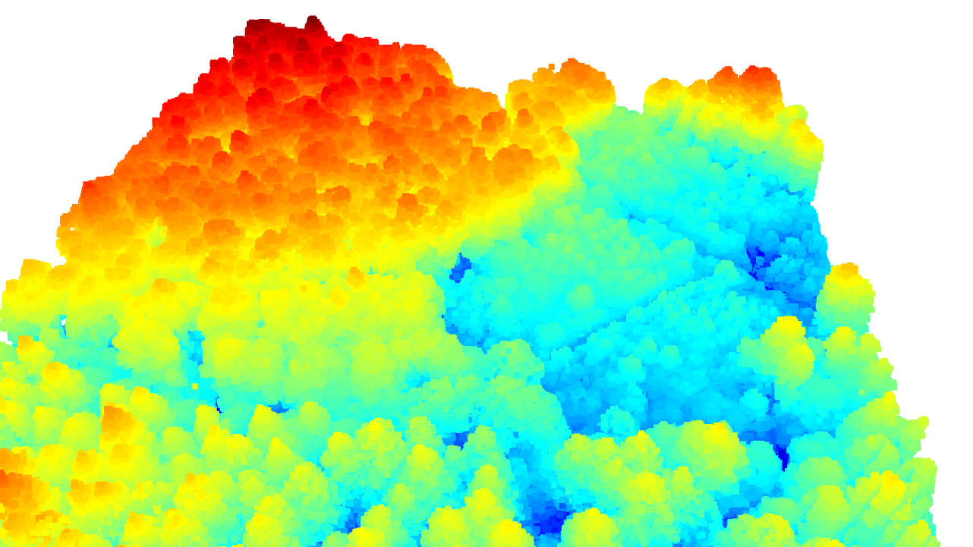
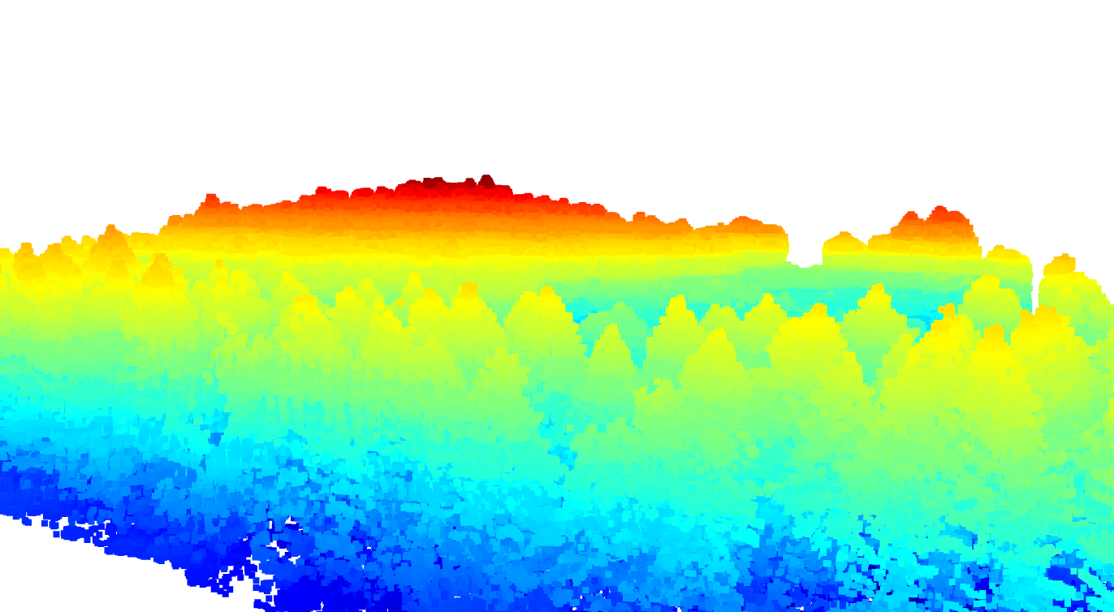
Dataset Preview

Slide 11
Forest Inventory Features
The final product will contain following features:
Tree Identification & Counting.
Tree Location Mapping.
Tree Attribute Extraction (Height,Crown Diameter,DBH,Wood Density).
Calculate Biomass.
Updating Forest Over Time.

Slide 12
Tree Segmentation Methodology
Pre-processing
Noise Removal
Detection
Segmentation

Slide 13
Tree Segmentation
Automated Tree Segmentation Pipeline
Big Data Challenge: Raw ULS LiDAR files are massive and unstructured.
Manual Bottleneck: Extracting individual trees manually is complex
for large forest blocks.
Objective: Automate the isolation of specific trees into an Extracted_ULS

Slide 14

Tree Segmentation
Algorithmic Solution Developed a Coordinate-Based Cylindrical Extraction using Python
Input: Raw Point Cloud
The algorithm doesn't use a fixed size. It calculates a specific cutting radius for each tree:

Slide 15
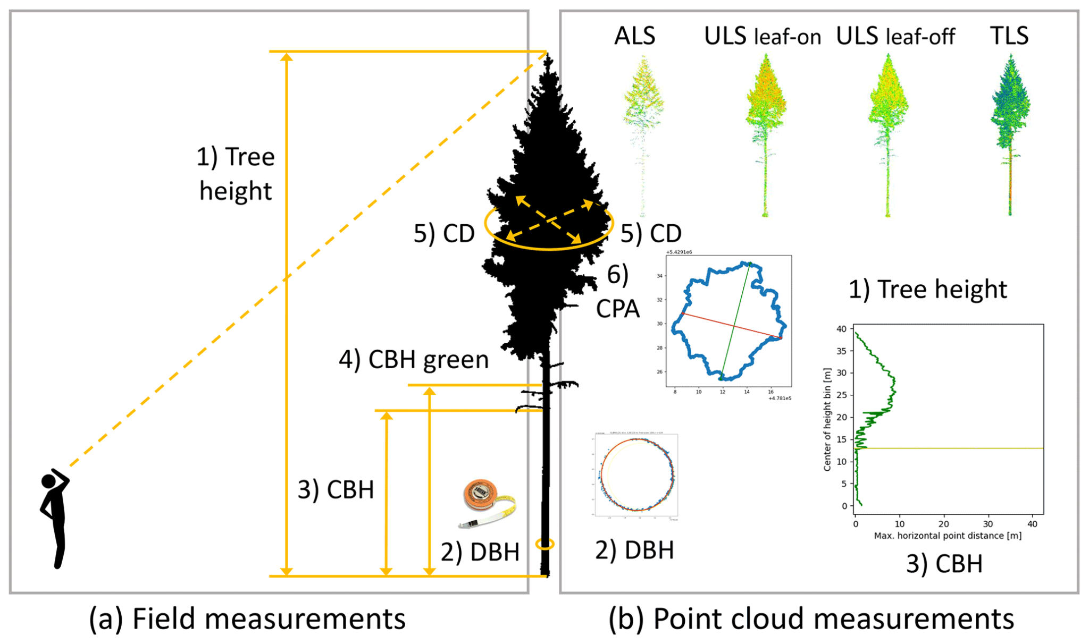
Tree Features

Slide 16
Feature Extraction & Biomass Estimation
Geometric Features: Tree Height & Crown Diameter.
AI Prediction: ML Regression Model for DBH.
Biomass Algo: Standard Chave et al. (2014) Equation.
Final Output: Automated Digital Inventory CSV.

Slide 17
Model Architecture
Model Used : Random Forest
Why this Model ? :
Handles tabular tree features effectively accuracy , implementation.
Robust and low risk of overfitting Requires minimal tuning
Project Task : DBH, Next Month Prediction
Data Split: training (80%) and testing (20%)
Training Trees: 360
Validation Trees: 90

Slide 18
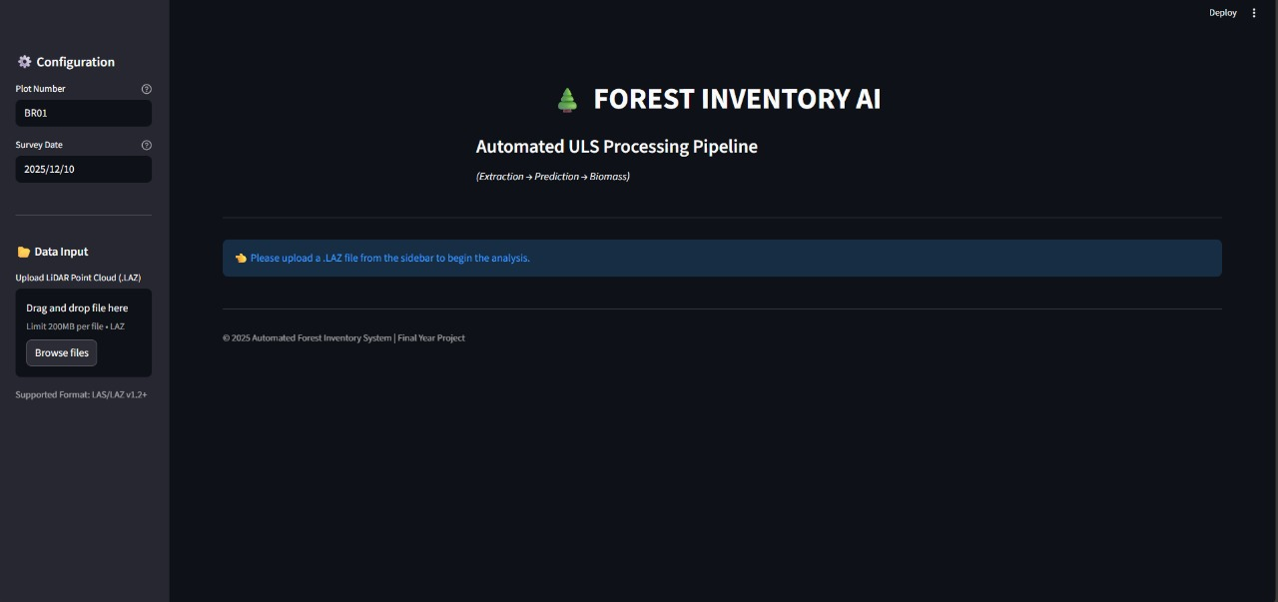
Web Prototype

Slide 19
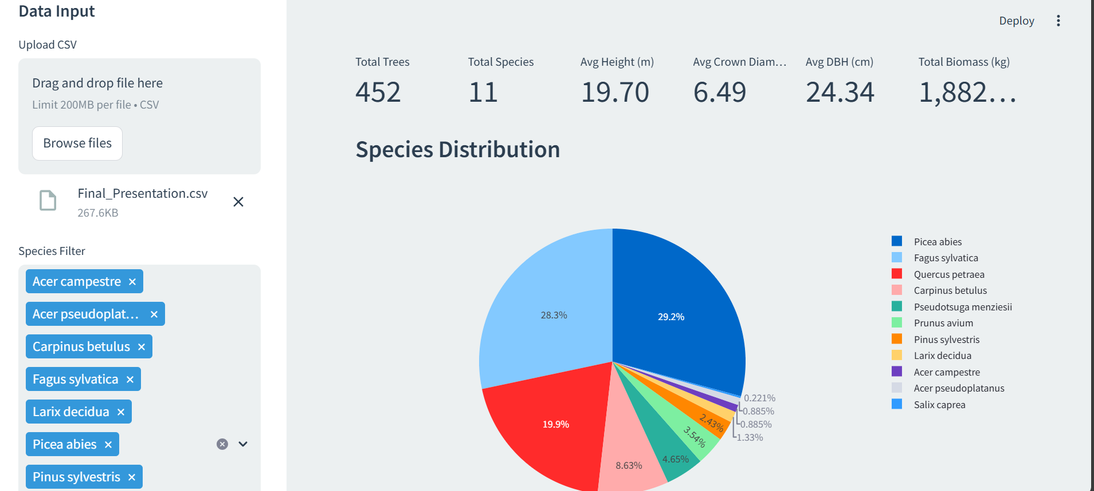
Web Prototype

Slide 20
Progress so far
Detected individual trees
Extracted tree-level features (e.g., height, crown area, spectral indices)
Trained a model to predict DBH from extracted features
Prepared a time-series framework to use previous month’s features
Trained a predictive model to estimate next month's DBH using past monthly data
Web prototype for simulation
Report done 40% +

Slide 21
Work Distribution FYP-1
Team Member | Task / Deliverable
Sadaqat Ali Shakir | Tree Segmentation
Ahmad Waheed | Tree Features Extraction
Noman Shahid | Model Training

Slide 22
References
Duncanson, L., & Dubayah, R. (2018). Monitoring individual tree-based change with airborne lidar. Ecology and Evolution, 8(11), 5489-5502. [DOI: 10.1002/ece3.4075] (P13)
Dietmaier, A., McDermid, G. J., Rahman, M. M., Linke, J., & Ludwig, R. (2019). Comparison of LiDAR and Digital Aerial Photogrammetry for Characterizing Canopy Openings in the Boreal Forest of Northern Alberta. Remote Sensing, 11(16), 1919. [DOI: 10.3390/rs11161919] (P3)
Feng, B., Nie, S., Wang, C., Xi, X., Wang, J., Zhou, G., & Wang, H. (2022). Exploring the Potential of UAV LiDAR Data for Trunk Point Extraction and Direct DBH Measurement. Remote Sensing, 14(12), 2753. [DOI: 10.3390/rs14122753] (P12)
Fu, H., Li, H., Dong, Y., Xu, F., & Chen, F. (2022). Segmenting Individual Tree from TLS Point Clouds Using Improved DBSCAN. Forests, 13(4), 566. [DOI: 10.3390/f13040566] (P6)

Slide 23
References
Lamping, J. E., Zald, H. S. J., Madurapperuma, B. D., & Graham, J. (2021). Comparison of Low-Cost Commercial Unpiloted Digital Aerial Photogrammetry to Airborne Laser Scanning across Multiple Forest Types in California, USA. Remote Sensing, 13(21), 4292. [DOI: 10.3390/rs13214292]
Moreira, B. M., Goyanes, G., Pina, P., Vassilev, O., & Heleno, S. (2021). Assessment of the Influence of Survey Design and Processing Choices on the Accuracy of Tree Diameter at Breast Height (DBH) Measurements Using UAV-Based Photogrammetry. Drones, 5(2), 43. [DOI: 10.3390/drones5020043]
Zhang, W., Qi, J., Wan, P., Wang, H., Xie, D., Wang, X., & Yan, G. (2016). An Easy-to-Use Airborne LiDAR Data Filtering Method Based on Cloth Simulation. Remote Sensing, 8(6), 501. [DOI: 10.3390/rs8060501]
Zhang, Y., Zou, Y., & Wang, Y. (2025). Remote Sensing of Forest Above-Ground Biomass Dynamics: A Review. Forests, 16(3), 821. [DOI: 10.3390/f16030821]

